Slide 1





CAPSTONE PROJECT
DATA HANDLING AND VIZUALIZATION FOR AUTOMATED PROCESSING
Educational Performance
Analysis and Insights Dashboard
Tamilarasan S (192224003)
Yuvanika G N (192224014)
Charukesh U B (192224120)
Created by Team

Slide 2
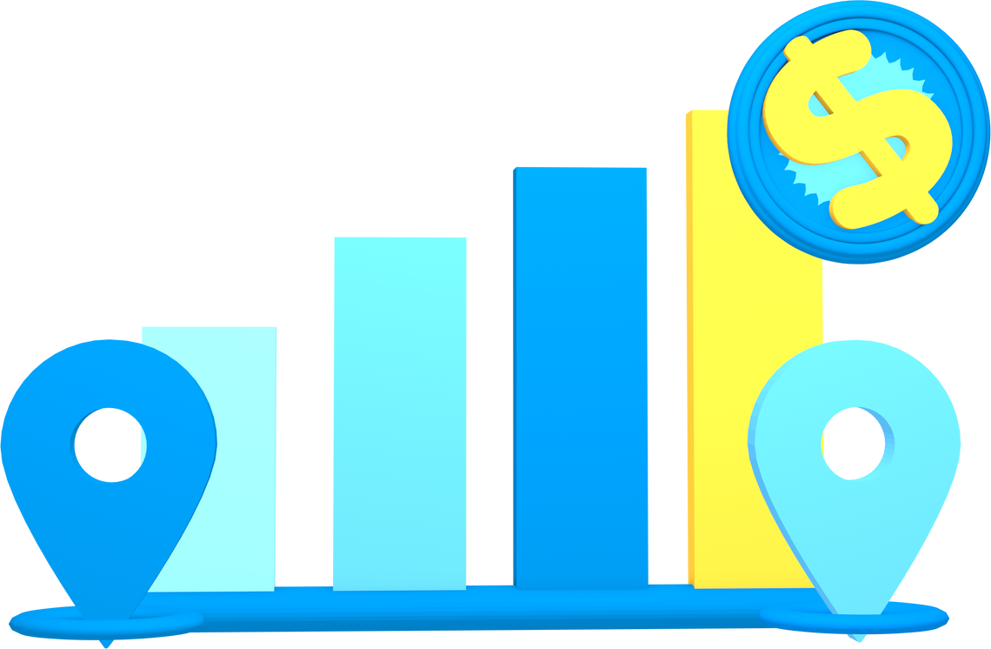
Table of
Content
Introduction
Code Skeleton
Problem Statement
Flow Diagram
Dataset Analysis
Output Samples
Environmental setup
Conclusion

Slide 3

Introduction
The "Comprehensive Educational Performance Analysis and Insights Dashboard" is an interactive Shiny application that provides detailed insights into educational performance data.
The dashboard displays a synthetic dataset with essential parameters such as student scores, gender, grade, subject, school type, instructor experience, and attendance rates. Users may filter and examine data using interactive features including school selection, subject, grade, gender, and score range.
The dashboard includes a summary table of important metrics, score distribution histograms, gender distribution analysis, and scatter graphs that demonstrate how scores relate to characteristics such as school resources, attendance rates, and teacher experience.
This program provides educators, administrators, and policymakers with a comprehensive and user-friendly interface for analysing student performance and allocating resources based on data.

Slide 4
Problem
Statement
Educational institutions must assess enormous amounts of data in order to better understand student performance, identify strengths and problems, and design improvement initiatives.
The quantity of data on student performance, attendance, demographics, and school resources provides an opportunity for thorough study, but it also necessitates an effective tool for visualizing and exploring these complicated statistics.
Summary
Analysis
Resource
Analysis
Score Distribution
Features
Attendance VS
Score Analysis
Gender Analysis
Teacher Analysis

Slide 5

Dataset Analysis
Detailed Breakdown
Gender Distribution: The dataset has an almost equal distribution of Male and Female students, providing a balanced view for gender-based analysis.
Grade and Subject Distribution: Students are distributed across Grades 9 to 12, and Subjects include Math, Science, English, and History.
Score Distribution: This allows categorization into "Excellent," "Good," "Average," and "Poor" performance levels.
School and School Type: The data includes students from four different schools (School A, B, C, and D)
Teacher Experience: The Teacher_Experience variable ranges from 1 to 15 years.
School Resources: School_Resources is a measure of the resources available at a school, ranging from 1 to 10.
Attendance Rate: The Attendance_Rate ranges from 70% to 100%. Analyzing attendance in relation to scores can identify the role of student presence in academic performance.
The dataset, sourced from the Kaggle website, consists of 1,000 records representing students from various schools
ATTRIBUTES :
Student_ID
Name
Gender
Grade
Subject
Score
School
School_Type
Teacher_Experience
School_Resources
Attendance_Rate

Slide 6

Environmental
Setup
Install R and RStudio
Run the App Locally
Ensure you have the latest version of R and RStudio installed on your system.
Use the R console or RStudio to run your Shiny app locally for testing.
Install Required Packages
tidyverse
shiny
ggplot2
plotly
DT
Testing and Debugging
Check for any errors or missing dependencies, and ensure all visualizations and data tables function as expected.
Generate Synthetic Data
Implement the data generation code to create your synthetic dataset and save it as a CSV file within the data/ folder.
Set Up R Scripts
Write your R code for the UI and server logic in the app.R file (or in ui.R and server.R if you separate them).

Slide 7

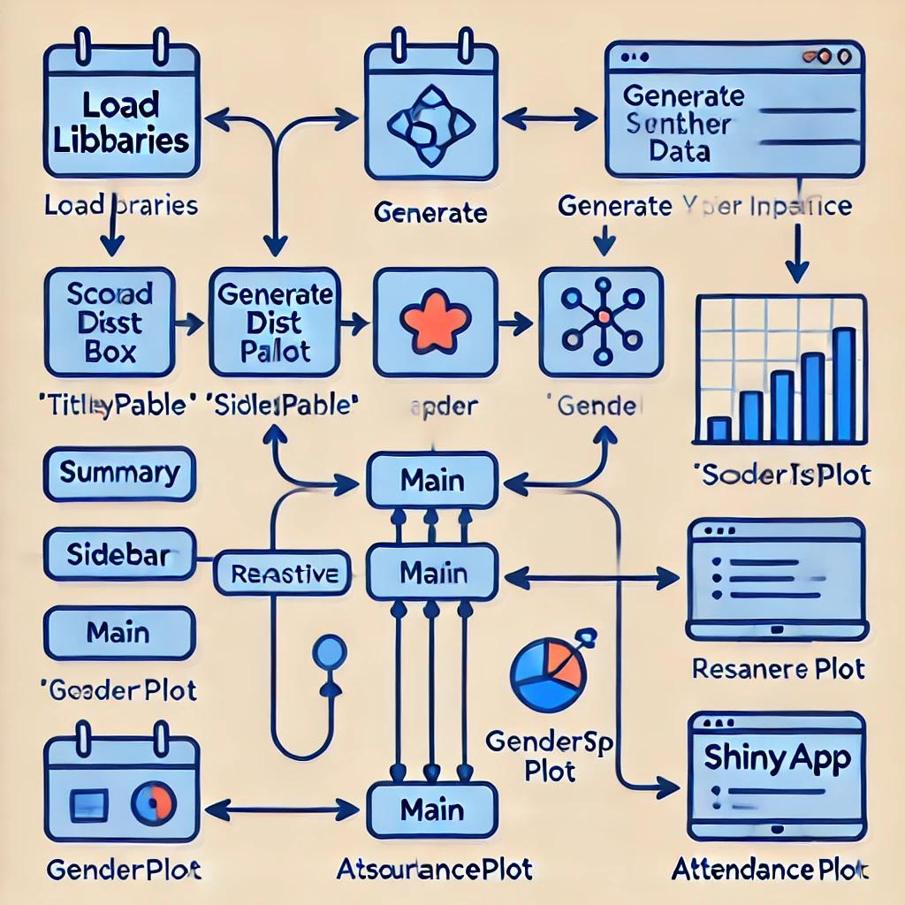
Code Skeleton & Flow Diagram
Load Libraries:
shiny, tidyverse, plotly, DT
Generate Synthetic Data:
Create synthetic data for use in the dashboard.
User Interface (UI):
Title panel, sidebar layout, sidebar panel, sidebar layout
Server:
Filtered_data, summary table, gender_plot, resourceplot, attendanceplot
ShinyApp
Combine the ui and server components to create and run the Shiny application.

Slide 8
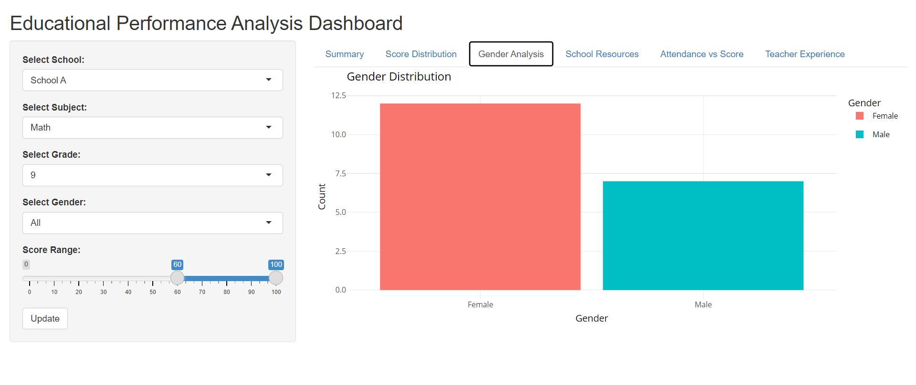

Output
Samples

Slide 9
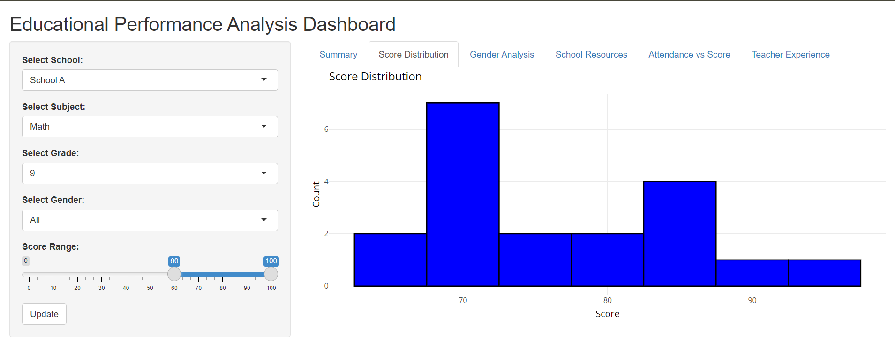
Output
Samples

Slide 10
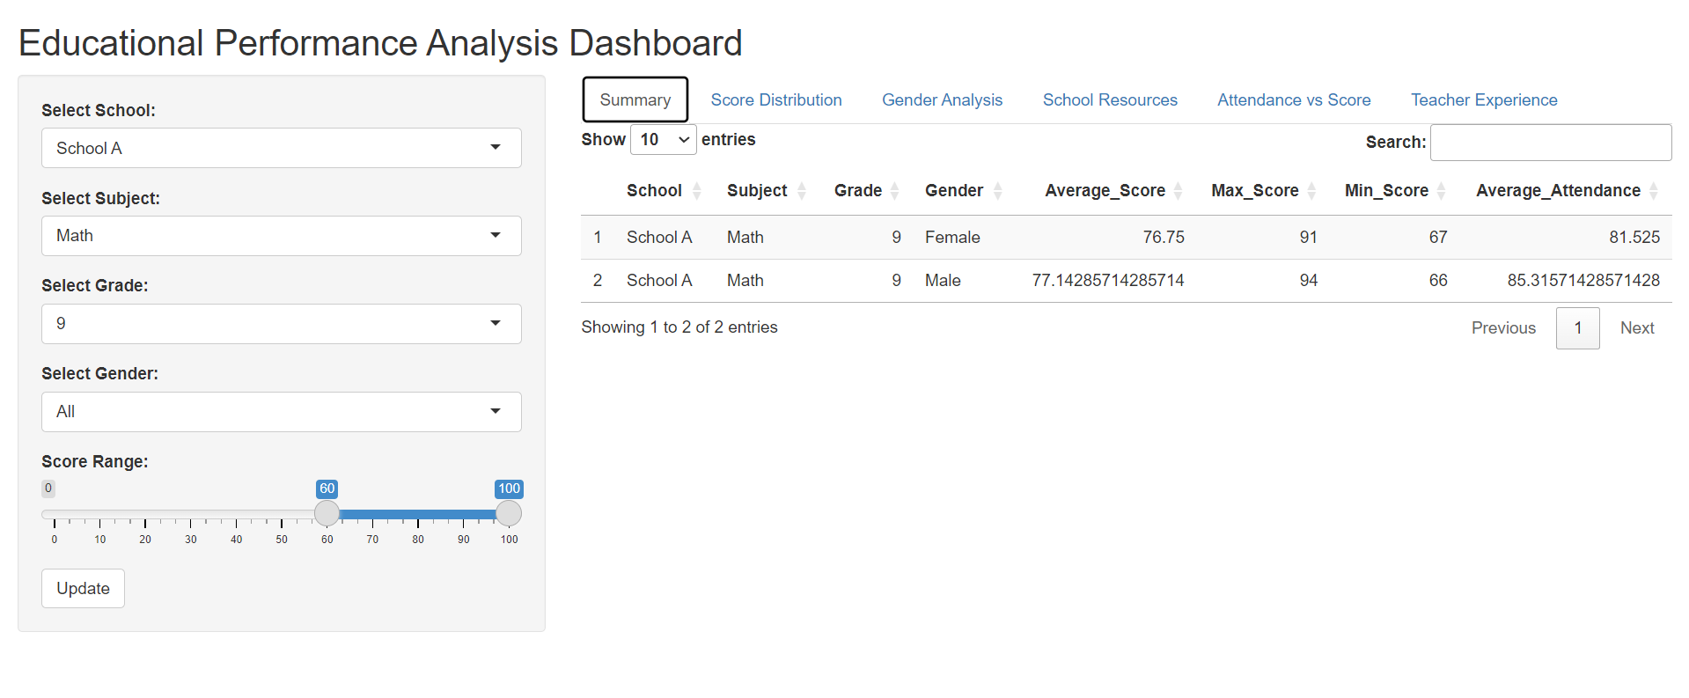
Output
Samples

Slide 11


Conclusion
This dashboard not only visualizes educational data but also provides actionable insights for educators and policymakers to enhance student performance and allocate resources more effectively. Regular analysis of this data can lead to continuous improvements in the educational landscape.

Slide 12
Thank You

